Slide 1
Neural Networks and Deep Learning (18CSE23)
(B.E (CSE) VII-Sem PE-V)
Unit-III Part-1 Presentation on
Unsupervised Learning Networks, Associative Memory Networks
By Dr. Kolla Morarjee Associate Professor, Department of CSE
Chaitanya Bharathi Institute of Technology, Hyderabad

Slide 2
UNSUPERVISED LEARNING
No help from the outside.
No training data, no information available on the desired output.
Learning by doing.
Used to pick out structure in the input:
Clustering,
Reduction of dimensionality → compression.
Example: Kohonen’s Learning Law.

Slide 3
FEW UNSUPERVISED LEARNING NETWORKS
There exists several networks under this category, such as
Kohonen Self-organizing Feature Maps,
Adaptive Resonance Theory.

Slide 4
SELF-ORGANIZATION
Network Organization is fundamental to the brain
Functional structure.
Layered structure.
Both parallel processing and serial processing require organization of the brain.

Slide 5
SELF-ORGANIZING FEATURE MAP
Our brain is dominated by the cerebral cortex, a very complex structure of billions of neurons and hundreds of billions of synapses. The cortex includes areas that are responsible for different human activities (motor, visual, auditory, etc.) and associated with different sensory inputs. One can say that each sensory input is mapped into a corresponding area of the cerebral cortex. The cortex is a self-organizing computational map in the human brain.

Slide 6
SELF-ORGANIZING NETWORKS
Discover significant patterns or features in the input data.
Discovery is done without a teacher.
Synaptic weights are changed according to local rules.
The changes affect a neuron’s immediate environment until a final configuration develops.

Slide 7
KOHONEN SELF-ORGANIZING FEATURE MAP (KSOFM)
The Kohonen model provides a topological mapping.
It places a fixed number of input patterns from the input layer into a higher dimensional output or Kohonen layer.
Training in the Kohonen network begins with the winner’s neighborhood of a fairly large size. Then, as training proceeds, the neighborhood size gradually decreases.
Kohonen SOMs result from the synergy of three basic processes
Competition,
Cooperation,
Adaptation.

Slide 8
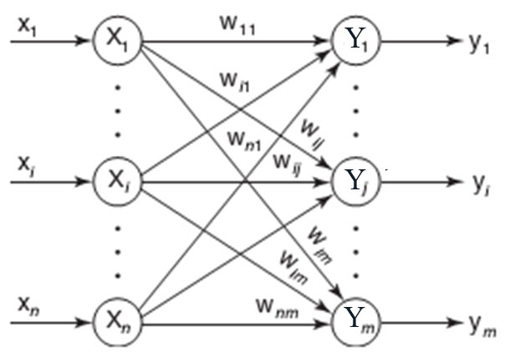
ARCHITECTURE OF KSOFM

Slide 9
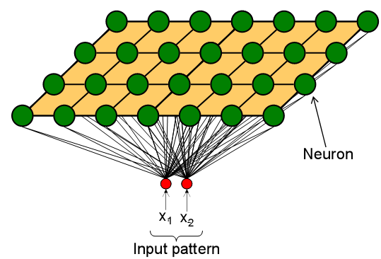
COMPETITION OF KSOFM
Each neuron in an SOM is assigned a weight vector with the same dimensionality N as the input space.
Any given input pattern is compared to the weight vector of each neuron and the closest neuron is declared the winner.
The Euclidean norm is commonly used to measure distance.

Slide 10
CO-OPERATION OF KSOFM
The activation of the winning neuron is spread to neurons in its immediate neighborhood.
This allows topologically close neurons to become sensitive to similar patterns.
The winner’s neighborhood is determined on the lattice topology.
Distance in the lattice is a function of the number of lateral connections to the winner.
The size of the neighborhood is initially large, but shrinks over time.
An initially large neighborhood promotes a topology-preserving mapping.
Smaller neighborhoods allow neurons to specialize in the latter stages of training.

Slide 11
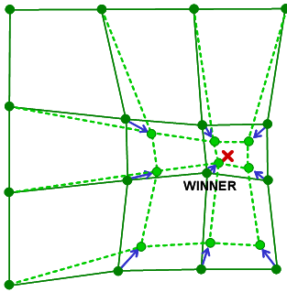
ADAPTATION OF KSOFM
During training, the winner neuron and its topological neighbors are adapted to make their weight vectors more similar to the input pattern that caused the activation.
Neurons that are closer to the winner will adapt more heavily than neurons that are further away.
The magnitude of the adaptation is controlled with a learning rate, which decays over time to ensure convergence of the SOM.

Slide 12
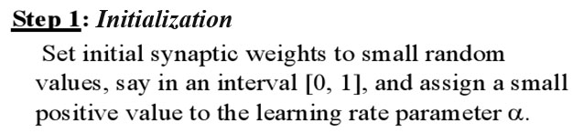
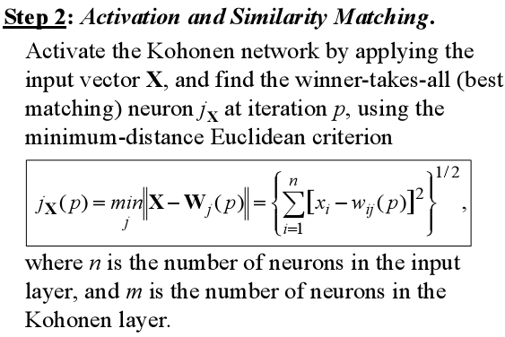
KSOFM ALGORITHM

Slide 13
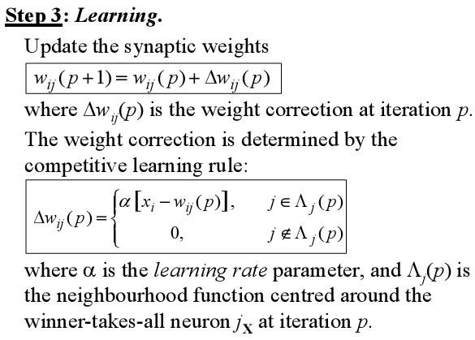
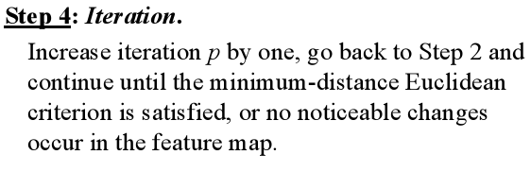

Slide 14
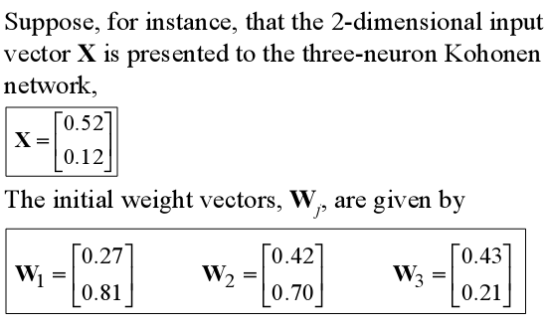
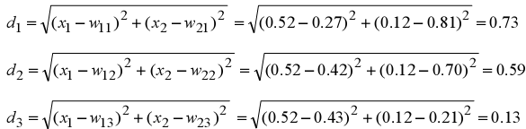
EXAMPLE OF KSOFM
Find the winning neuron using the Euclidean distance:

Slide 15


Neuron 3 is the winner and its weight vector W₃ is updated according to the competitive learning rule:
The updated weight vector W3 at iteration (p+1) is determined as:
The weight vector W3 of the winning neuron 3 becomes closer to the input vector X with each iteration.

Slide 16
ADAPTIVE RESONANCE THEORY (ART) NETWORK
Adaptive Resonance Theory (ART) is a family of algorithms for unsupervised learning developed by Carpenter and Grossberg.
ART is similar to many iterative clustering algorithms where each pattern is processed by
finding the "nearest" cluster (a.k.a. prototype or template) to that exemplar (desired).
updating that cluster to be "closer" to the exemplar.

Slide 17
ARCHITECTURES OF ART NETWORK
ART1, designed for binary features.
ART2, designed for continuous (analog) features.
ARTMAP, a supervised version of ART.

Slide 18
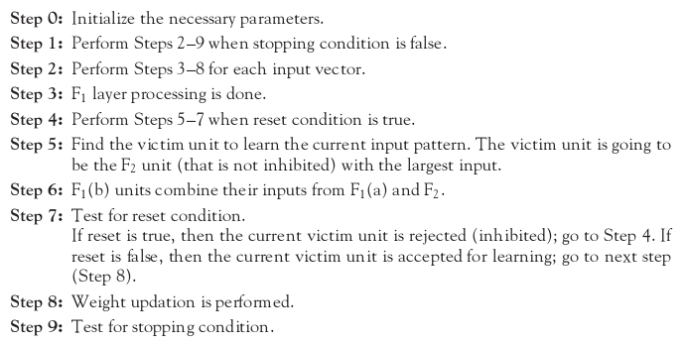
FUNDAMENTAL ALGORITHM OF ART NETWORK

Slide 19
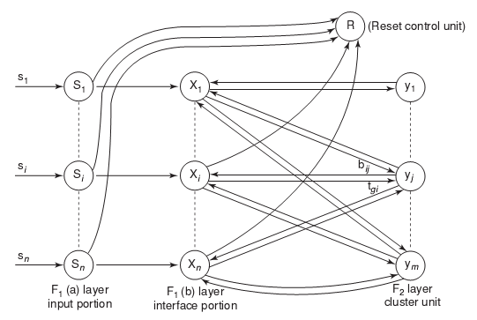
BASIC ARCHITECTURE OF ART1

Slide 20
ART1 UNITS
ART1 Network is made up of two units
Computational units
Input unit (F1 unit – input and interface).
Cluster unit (F2 unit – output).
Reset control unit (controls degree of similarity).
Supplemental units
One reset control unit.
Two gain control units.

Slide 21
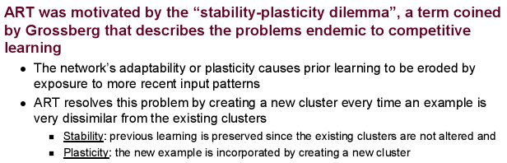
ART2 NETWORK

Slide 22
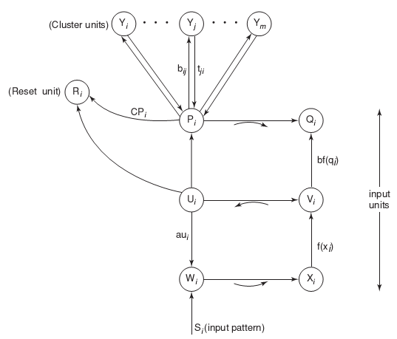
BASIC ARCHITECTURE OF ART2

Slide 23
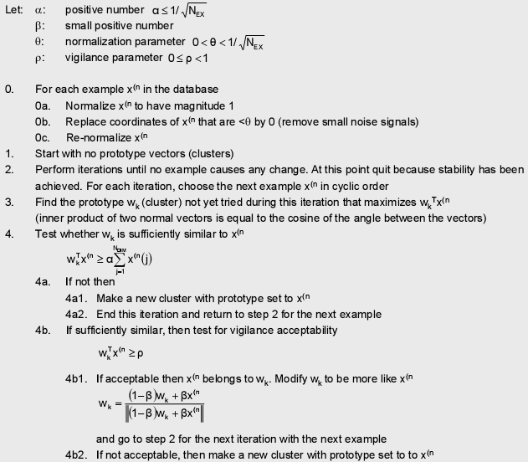
ART2 ALGORITHM

Slide 24
PATTERN ASSOCIATION
Associating patterns which are
similar,
contrary,
in close proximity (spatial),
in close succession (temporal).
Associative recall
evoke associated patterns,
recall a pattern by part of it,
evoke/recall with incomplete/noisy patterns.

Slide 25
ASSOCIATIVE MEMORY (AM) NETWORK
Two types of associations exist. For two patterns s and t
hetero-association (s != t): relating two different patterns (s – input, t – target).
auto-association (s = t): relating parts of a pattern with other parts.
Architectures of NN associative memory:
single layer (with/out input layer),
two layers (for bidirectional association)
Learning algorithms for AM:
Hebbian learning rule and its variations,
gradient descent.

Slide 26
ASSOCIATIVE MEMORY NETWORK
WORKING PROCESS
Recall a stored pattern by a noisy input pattern.
Using the weights that capture the association.
Stored patterns are viewed as “attractors”, each has its “attraction basin”.
Often call this type of NN “associative memory” (recall by association, not explicit indexing/addressing).

Slide 27
TRAINING ALGORITHM FOR ASSOCIATIVE MEMORY NETWORK
Network structure: single layer
one output layer of non-linear units and one input layer.
s_1
x_1
w_11
y_1
t_1
w_1m
w_n1
s_n
x_n
w_nm
y_m
t_m
Goal of learning:
to obtain a set of weights w_ij from a set of training pattern pairs {s:t} such that when s is applied to the input layer, t is computed at the output layer,
for all training pairs s:t, tj = f(sTwj) for all j.

Slide 28
HEBB RULE FOR PATTERN ASSOCIATION
Algorithm (bipolar or binary patterns):
For each training samples s:t:
are ON (binary) or have the same sign (bipolar).
Instead of obtaining W by iterative updates, it can be computed from the training set by calculating the outer product of s and t.

Slide 29
OUTER PRODUCT FOR PATTERN ASSOCIATION
Let s and t be row vectors.
Then for a particular training pair s:t
and

Slide 30
TEST/ RECALL THE NETWORK
(1 0 0 0), (1 1 0 0) class (1, 0)
(0 0 0 1), (0 0 1 1) class (0, 1)
(0 1 1 0) is not sufficiently similar to any class

Slide 31
STORAGE CAPACITY
Number of patterns that can be correctly stored & recalled by a network.
More patterns can be stored if they are not similar to each other (e.g., orthogonal).
Non-orthogonal
Orthogonal

Slide 32
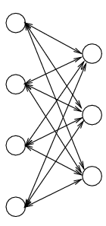
BIDIRECTIONAL ASSOCIATIVE MEMORY (BAM) NETWORK
Architecture:
Two layers of non-linear units: X-layer, Y-layer.
Units: discrete threshold, continuing sigmoid (can be either binary or bipolar).
Weights:
Symmetric:
Convert binary patterns to bipolar when constructing W.

Slide 33
RECALL OF BAM NETWORK
Bidirectional, either by X (to recall Y) or by Y (to recall X).
Recurrent:
Update can be either asynchronous (as in hetero-associative memory) or synchronous (change all Y units at one time, then all X units the next time).

Slide 34




ACTIVATION FUNCTIONS IN BAM
The activation function is based on whether the input target vector pairs used are binary or bipolar.
Activation function for the Y-layer | Activation function for the X-layer
With binary input vectors | With binary input vectors
With bipolar input vectors | With bipolar input vectors

Slide 35
DISCRETE HOPFIELD NETWORK (DHN)
A single-layer network
each node as both input and output units.
More than an Associative Memory, Discrete Hopfield Network can be used in several applications.
Other applications such as combinatorial optimization.
Different forms: discrete & continuous.
Major contribution of John Hopfield to NN:
Treating a network as a dynamic system.
Introduction of energy function into Neural Network Research.

Slide 36
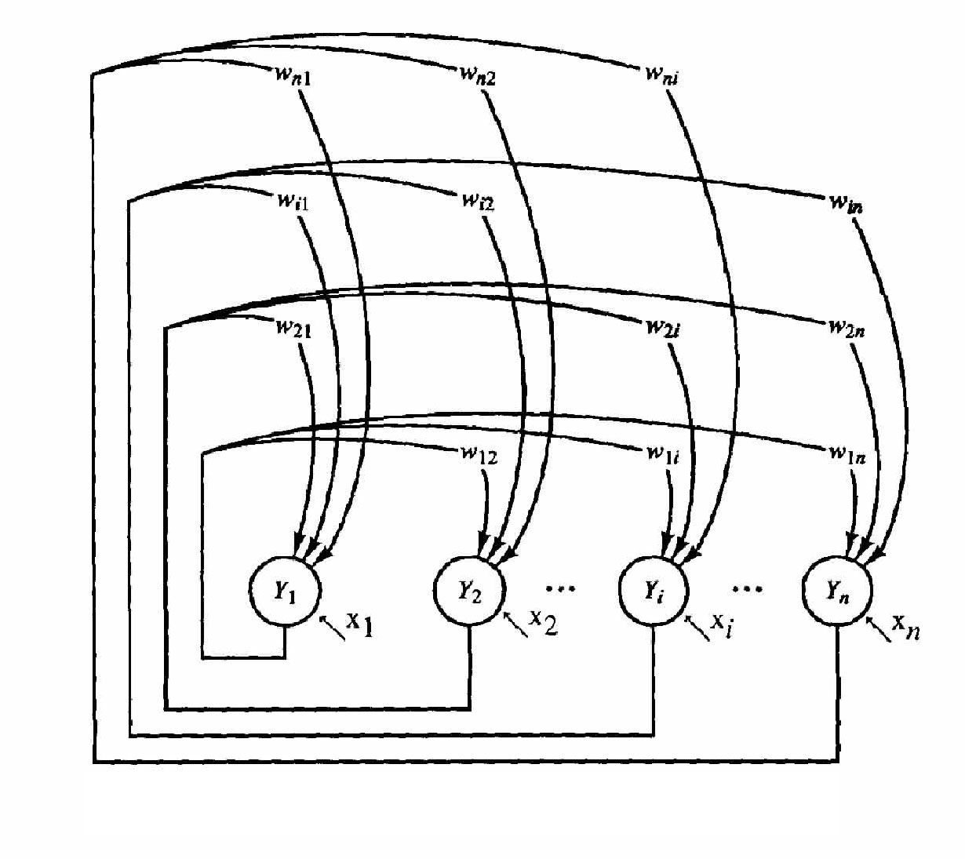
ARCHITECTURE OF DHN
Architecture
Single-layer (units serve as both input and output):
nodes are threshold units (binary or bipolar).
weights: fully connected, symmetric, and zero diagonal.
x_{i} are external inputs, which may be transient or permanent.

Slide 37
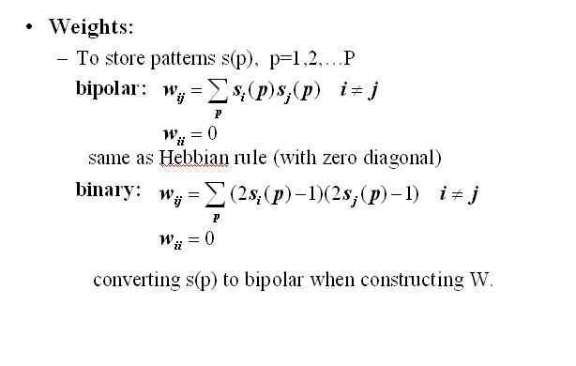

Slide 38
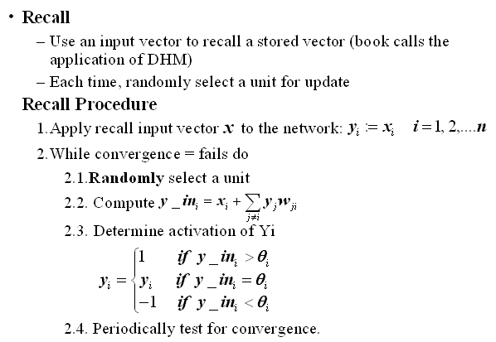

Slide 39
STORAGE CAPACITY OF DHN
P: maximum number of random patterns of dimension n can be stored in a DHM of n nodes
Hopfield’s observation:
Theoretical analysis:
P/n decreases because larger n leads to more interference between stored patterns.
Some work to modify HM to increase its capacity to close to n, W is trained (not computed by Hebbian rule).

Slide 40
CONTINUOUS HOPFIELD NET
Architecture
Continuous node output, and continuous time
Fully connected with symmetric weights
Internal activation
Output (state)
where f is a sigmoid function to ensure binary/bipolar output. E.g. for bipolar, use hyperbolic tangent function:

Slide 41
CONTINUOUS HOPFIELD NET
Computation: all units change their output (states) at the same time, based on states of all others.
Compute net:
Compute internal activation by first-order Taylor expansion
Compute output

Slide 42
SUMMARY
This chapter discussed on the various associative networks:
Kohonen Self-organizing Feature Maps
Adaptive Resonance Theory
Bidirectional Associative Memory Network
Hopfield Nets

